Slide 1
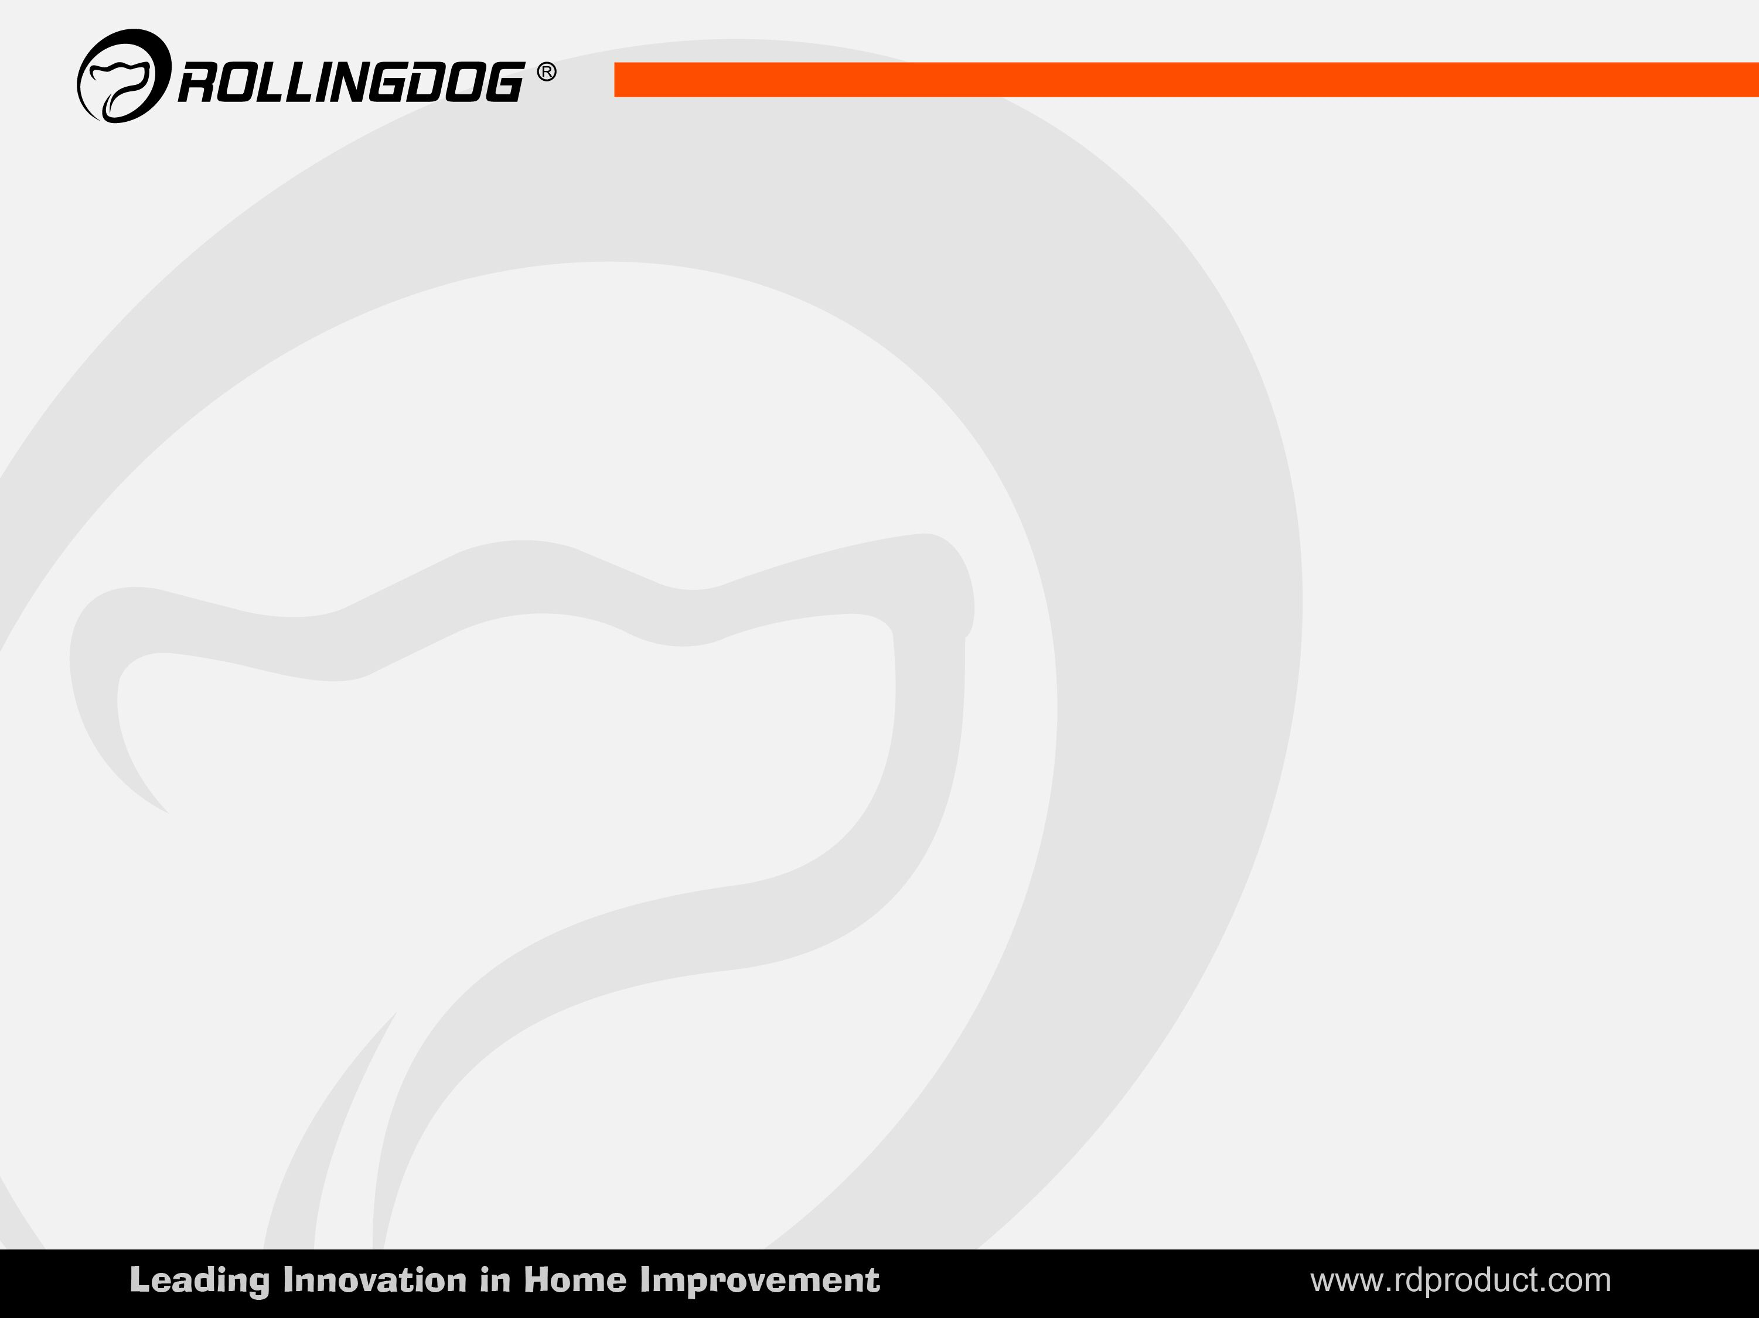
DIY MARKET RESEARCH IN FRANCE
LUCIO LIU & VICKY QIN

Slide 2
Contents
I. France DIY market overview
II. DIY market in building materials stores
a. Tradional Distribution Channel
b. Medium sizes DIY outlets
c. Big Surface DIY outlets
III. DIY market in other retailers:
a. Hypermarket
b. Online sales
c. Discount store
IV. Main brands of painting tools in France
V. Main brands of paint manufacturer in France
VI. Details of painting tools in France

Slide 3
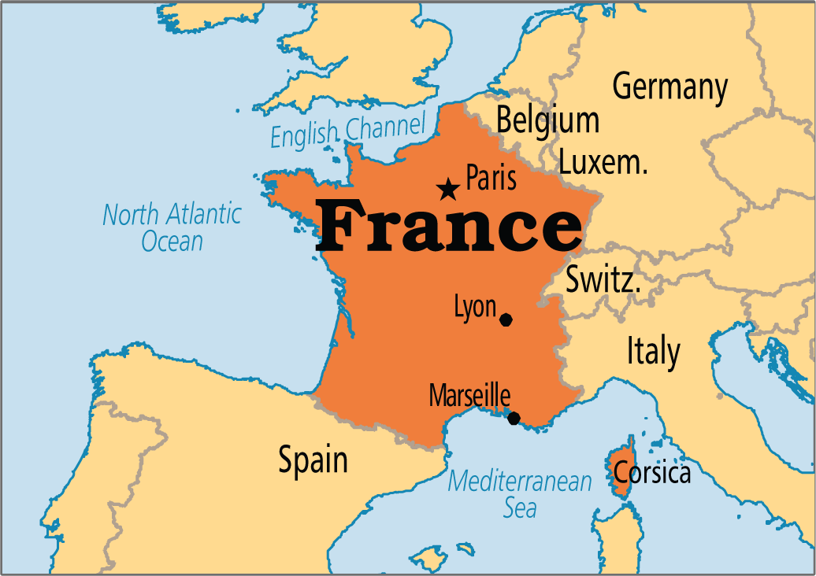
I. France DIY market overview
The French Republic
Area: 672,834 km²
GDP: $2465.45 billion
GDP per capita: $36,855
Population 2016: 66.90 million
Average inflation 2016: 0.18 %

Slide 4
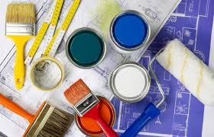
DIY market in France grow with the market
The French home improvement and DIY market picked up pace again in 2016, surpassing the sales level of € 25 bn.
The overall market volume increased in 2016 by 1.9 % to
€ 25.408 bn, while DIY stores grew their sales compared with the previous year by 1.6% to around € 19.648 bn.
They thus remain the biggest distribution channel by a large margin, although their share of the overall market fell by 1% to 77%.
They surrendered this percentage point to
e-commerce, which increased its share to
3% and € 711 mio.

Slide 5
II. DIY market in building materials stores
The retail distribution chains and networks are highly concentrated.
In many sectors, independent wholesale and retail outlets are disappearing rapidly and being replaced by retail distribution chains and networks.
Small and medium-sized family-owned firms, which traditionally accounted for a majority of French wholesale and retail trade, are rapidly losing ground to hypermarkets.
At the same time, direct marketing, Internet sales, and specialised chain stores have shown strong growth.

Slide 6
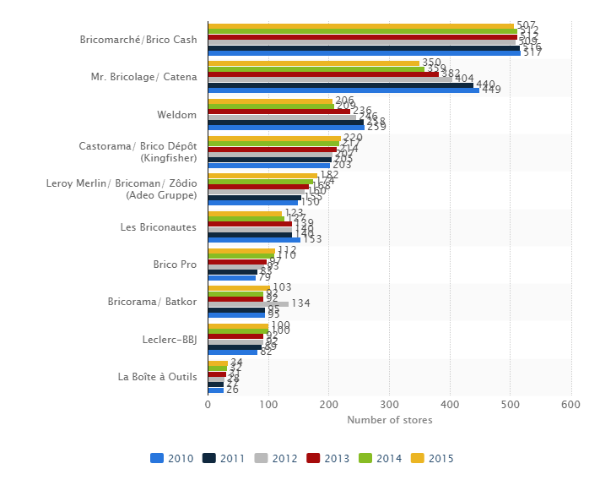
Leading DIY retailers in France from 2010 to 2015

Slide 7
Market share of DIY market in France 2016
Leroy Merlin：one point more than in the previous year
Castorama: losing one percentage point
Groupe Bourrelier: down one point
Cofac: up one point

Slide 8
a. Tradional Distribution Channel

Slide 9
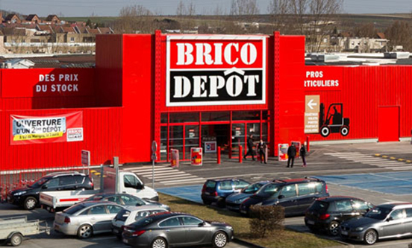
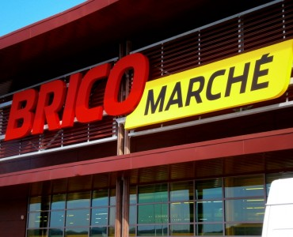
b. Medium sizes DIY outlets
Brico Dépôt
www.bricodepot.com
119 stores, average Size 5605m² ,
offers customers a choice of 10,500 DIY and renovation products
Bricomarché
www.bricomarche.com
80 stores, average Size 2092m^{2,}
being able to do everything cheaper

Slide 10
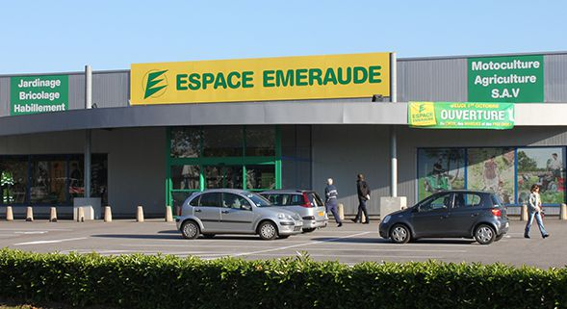
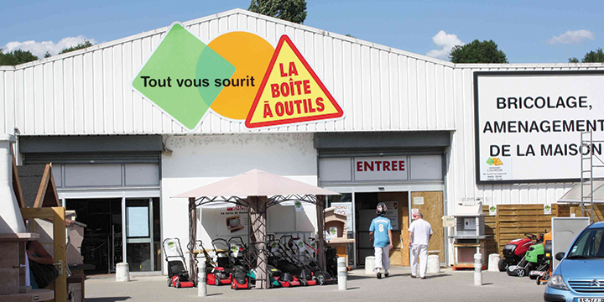
Espace Emeraude
www.espace-emeraude.fr
90 stores, average Size 1500m²,
specialist for garden and home equipment
La boîte à Outils
www.laboiteaoutils.fr
11 stores located in rural areas or close to
medium-sized agglomerations, average Size 2640m²

Slide 11
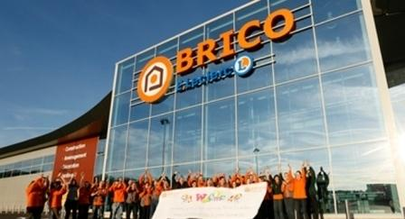
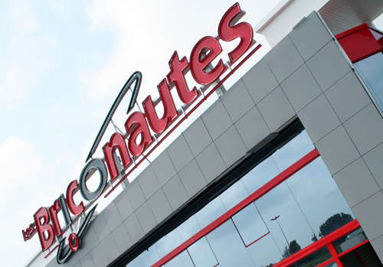
Leclerc-BBJ
www.e-leclerc.com
569 stores, average Size 2935m²,
is a wholesaler / semi-wholesale service
Les Briconautes
www.les-briconautes.fr
153 stores, average Size 2200m²,
is a gardening franchise, specializing in durable and solid garden sheds.

Slide 12
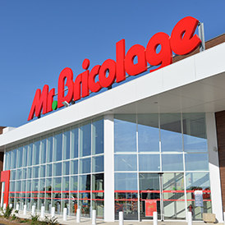
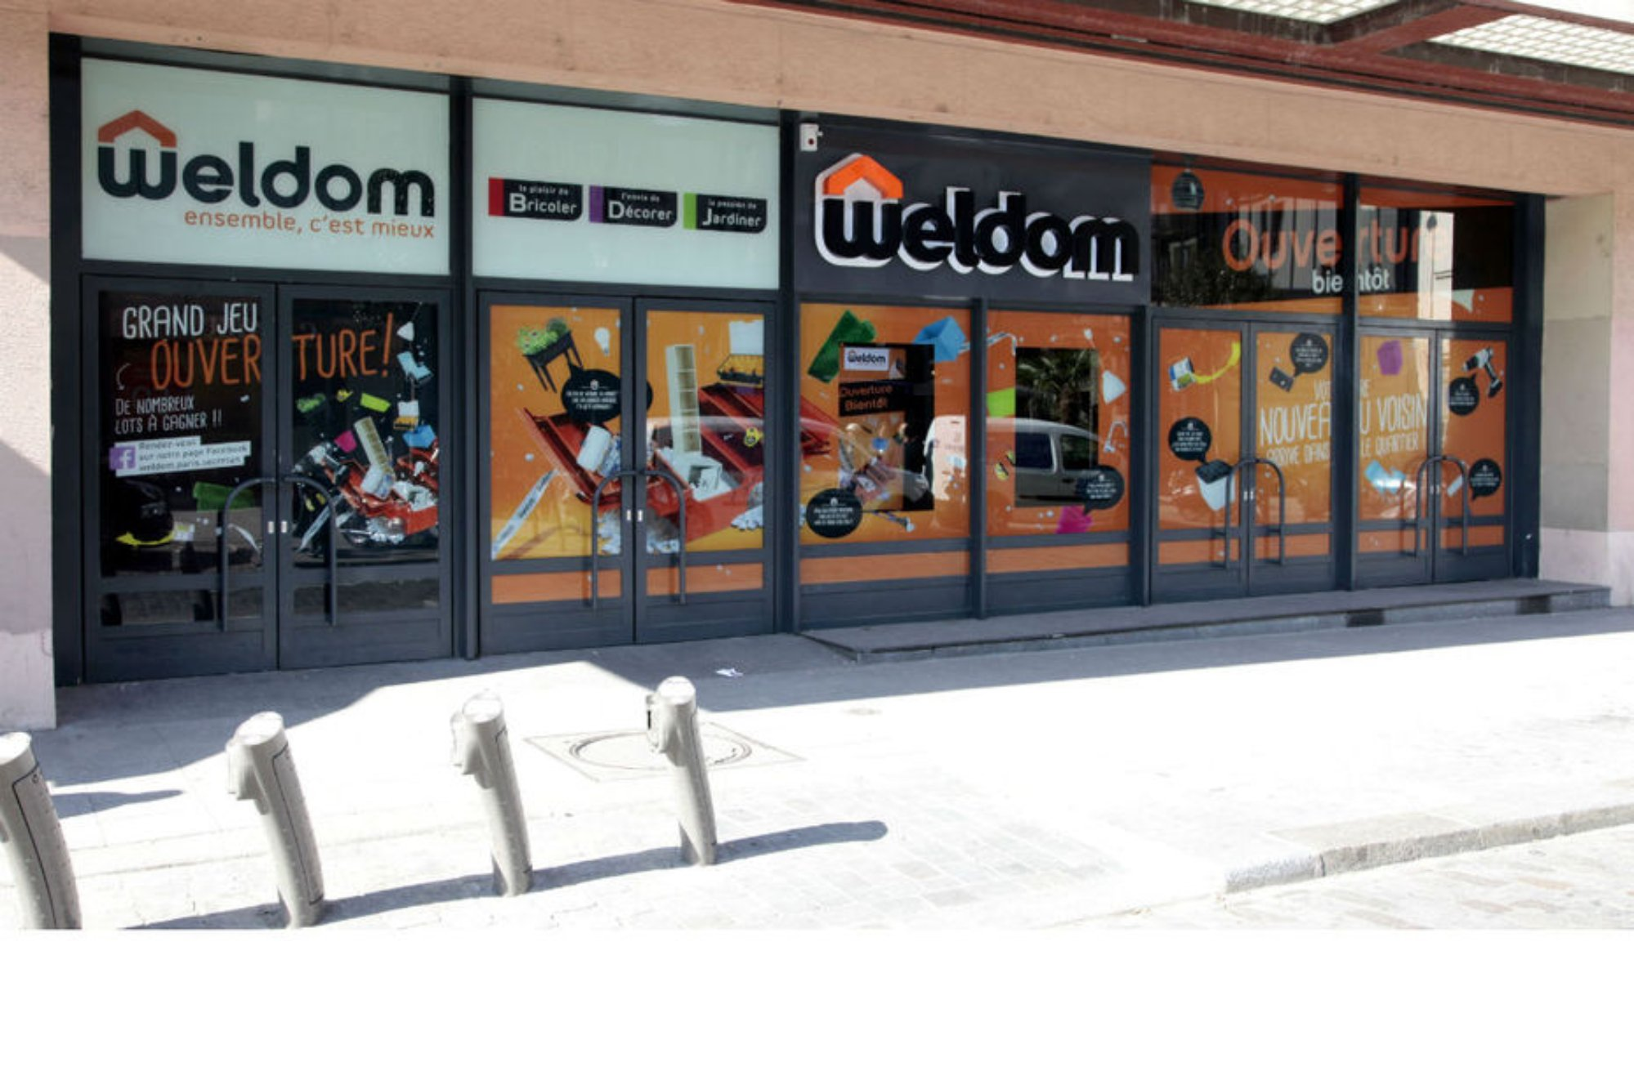
Mr. Bricolage
www.mr-bricolage.fr
Average Size 2900m², has around 80 shops
and 435 franchise stores across France,
also has operations across numerous European countries, as well as in South America and North Africa
Weldom
www.weldom.com
211 stores, 22 of which are integrated,
average Size 2392m², with 26,000 products

Slide 13
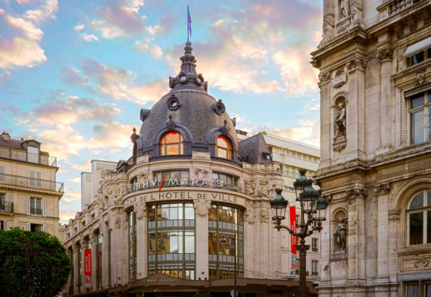
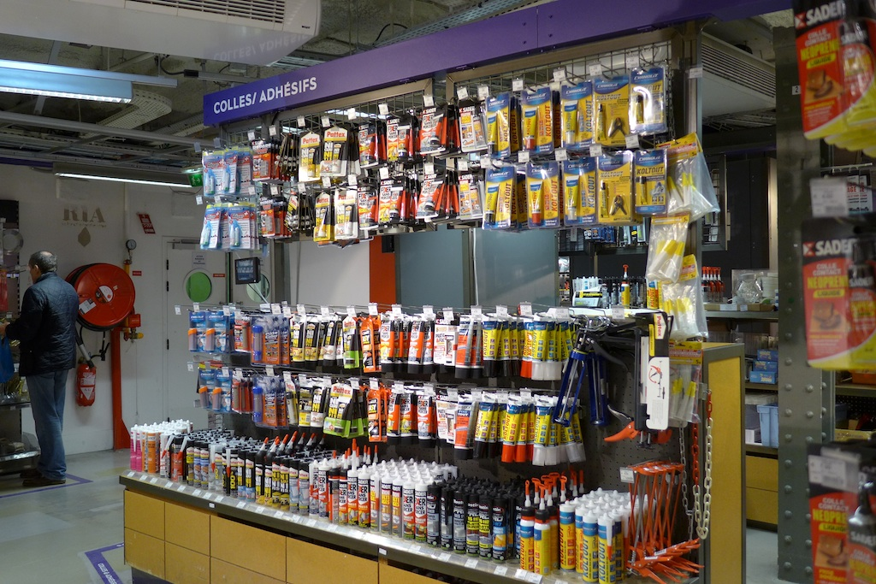
c. Big Surface DIY outlets
BHV
www.bhv.fr
11 stores in France, average 70,000 visitors every day,
average size: 45,000 m²

Slide 14
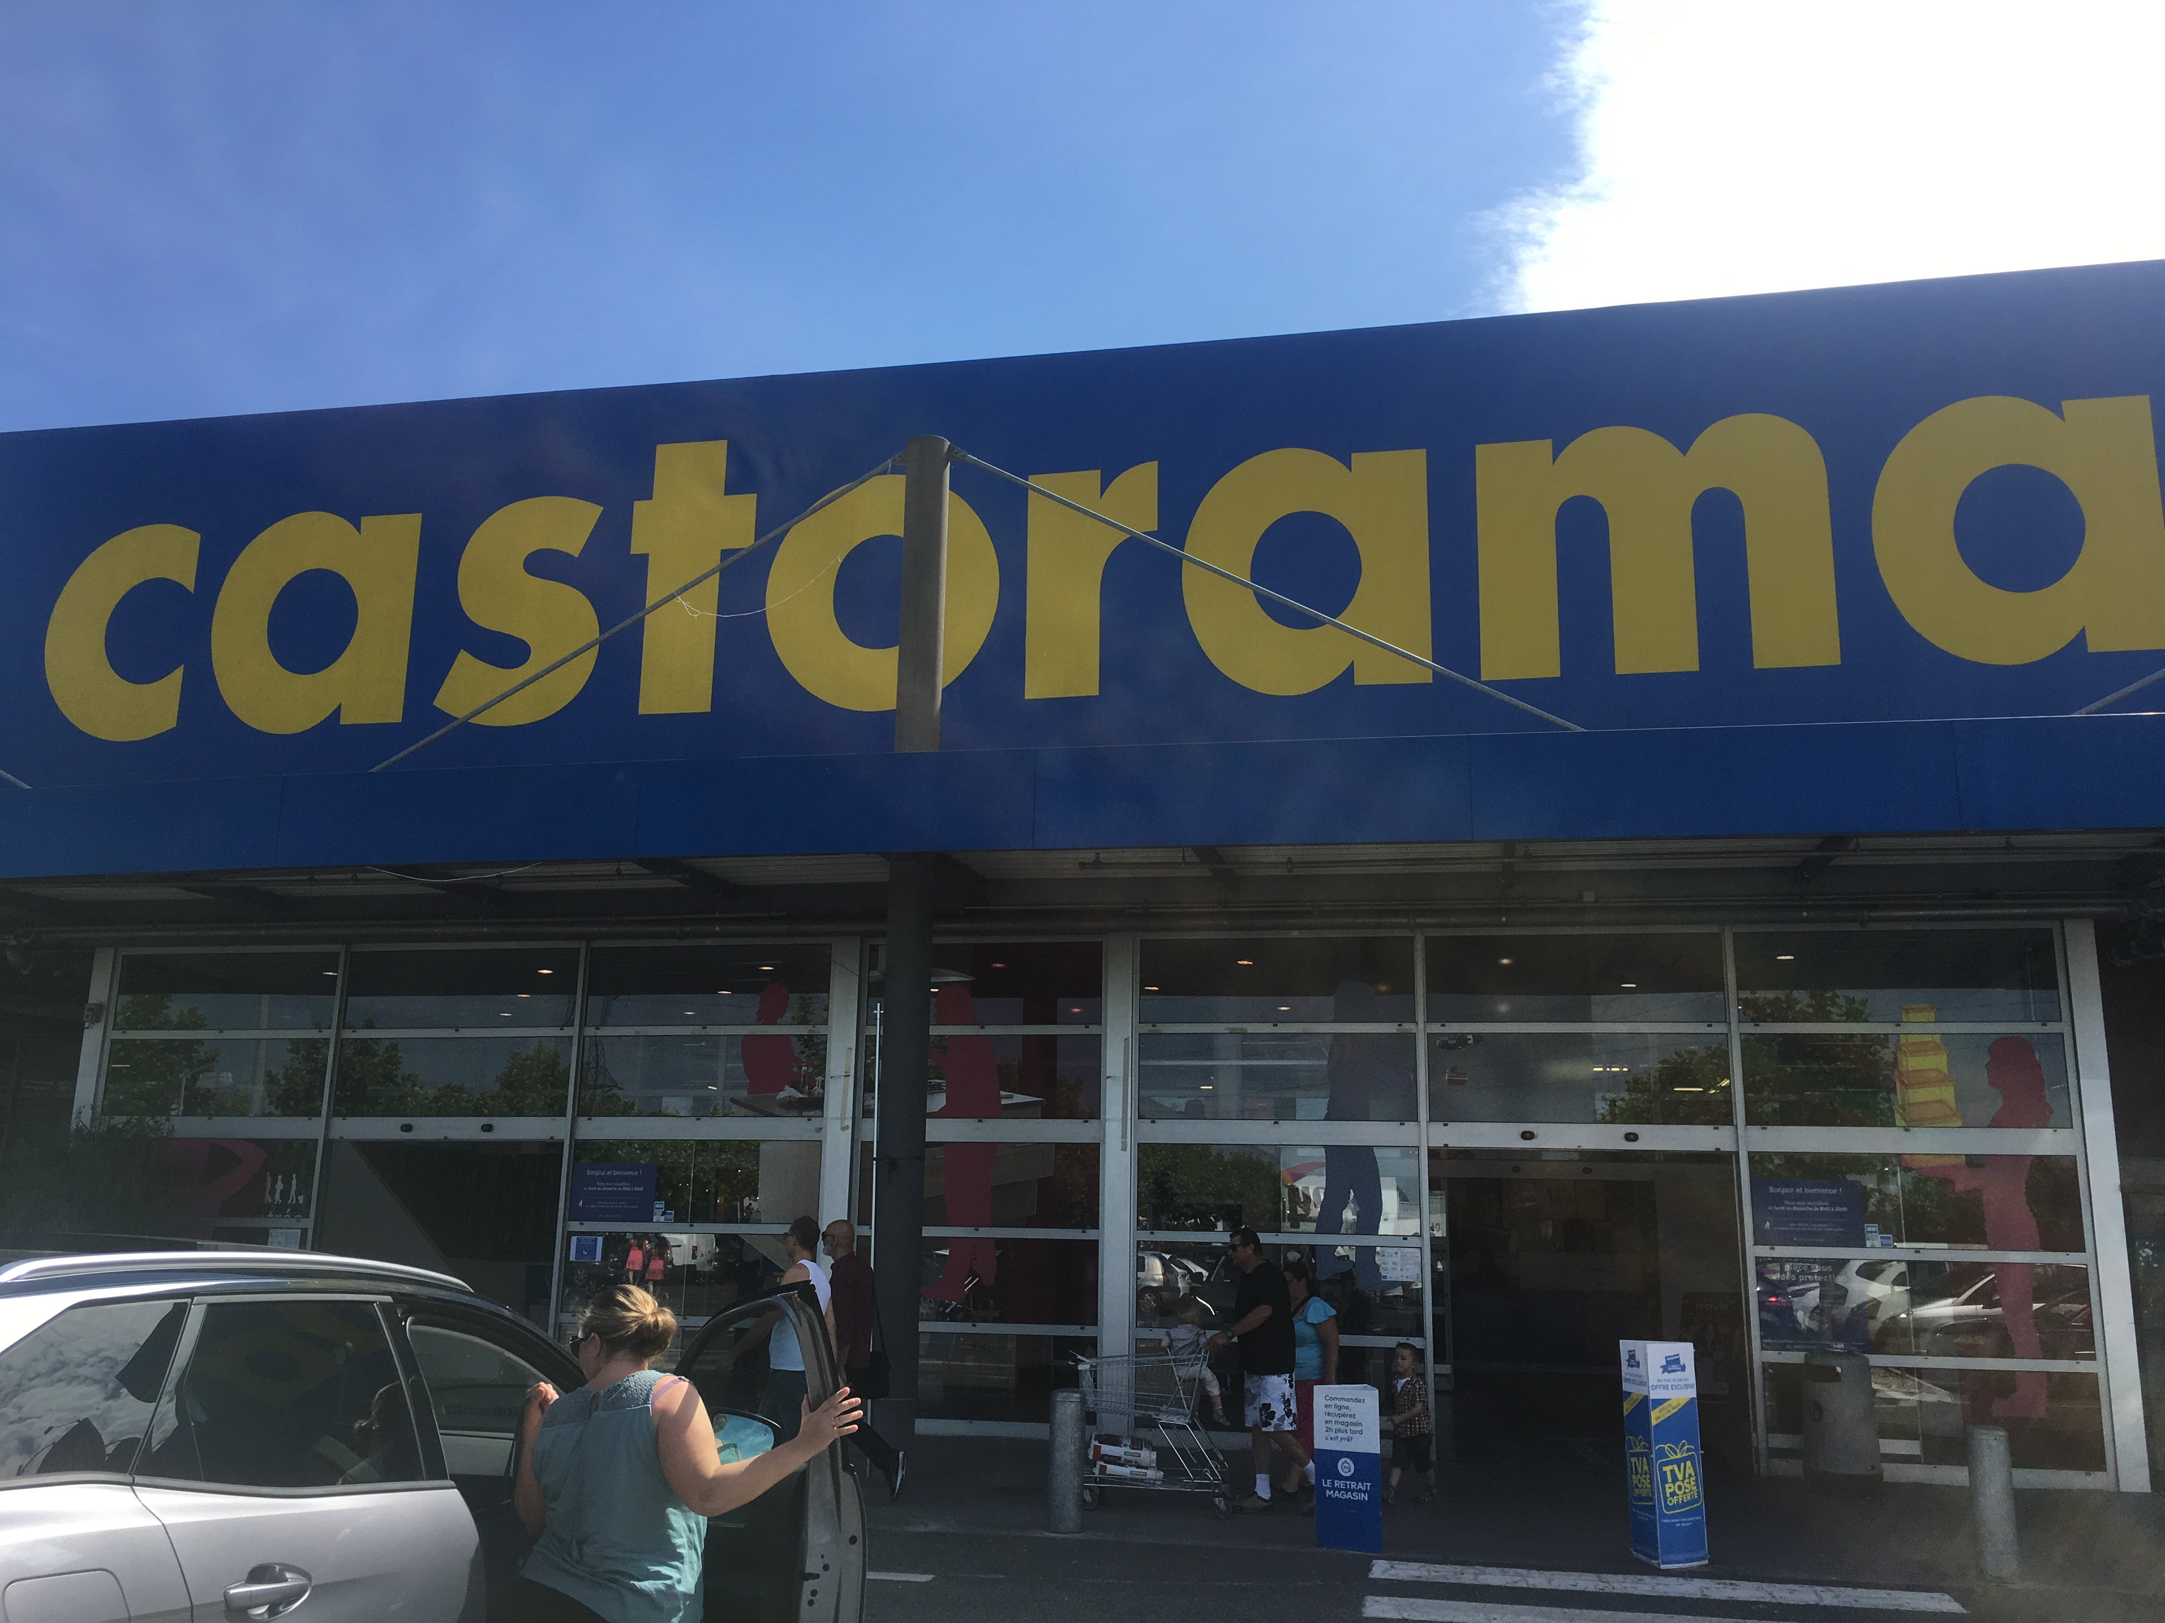
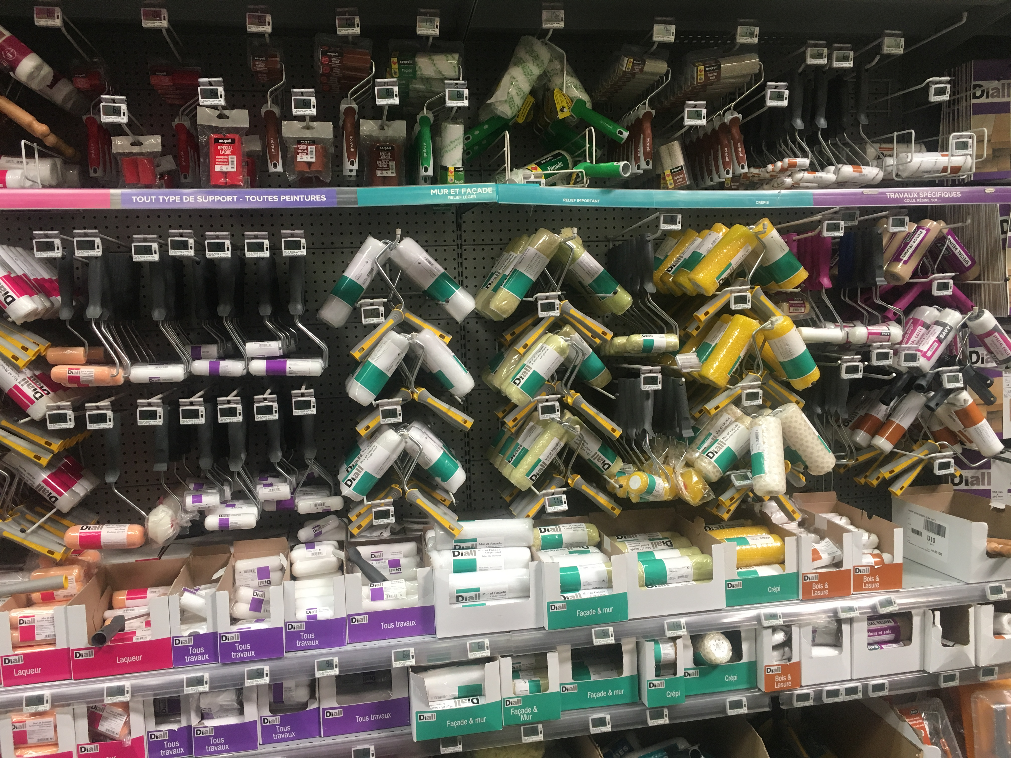
Castorama
www.castorama.fr
102 stores in France, with up to 50,000 products, average size:10,864 m²

Slide 15
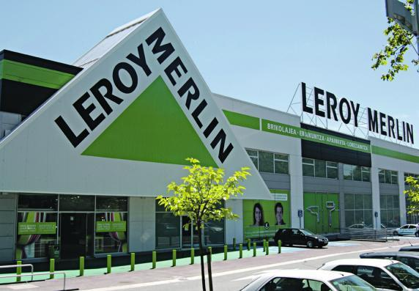
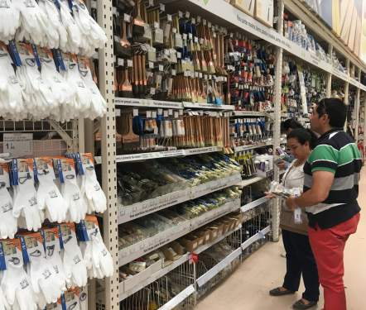
Leroy Merlin
www.leroymerlin.fr
80 stores opened since 1980，€ 6.2 billion in sales, average size:10,500 m²

Slide 16
III. DIY market in other retailers
a. Hypermarket
Hypermarkets are defined as stores with a minimum selling area of 2,500 square meters.
French hypermarkets offer 25,000-40,000 products for sale at competitive prices, of which 3,000-5,000 food items and 20,000-35,000 non-food articles.
Generally located in suburbs, they cover a total sales area of 11.1 million square meters.
As of 2015, there were 2091 hypermarkets, employing over 330,574 people. The top five hypermarket companies are Leclerc, Carrefour, Intermarché, Système U, Casino, and Auchan.

Slide 17
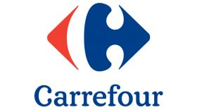
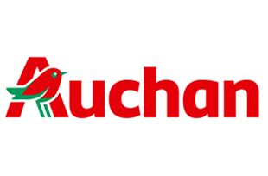
CARREFOUR
www.carrefour.fr
Established in 1958, there are 10,102 stores
in 30 countries around the world,
including 221 local giant supermarkets,
1021 large supermarkets, 3245 convenience stores
in France.
AUCHAN
www.auchan.fr
Operating 3051 stores in 16 countries(large stores mainly),
including 126 local giant supermarkets,
268 large supermarkets, 108 small supermarkets
in France.

Slide 18
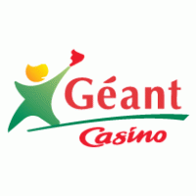
GEANT
www.geant.fr
Another very powerful large-scale integrated
supermarket, has merged with CASINO Group.
Géant Casino: Established in 1970, it belongs to
the chain of supermarkets and has nearly 120
stores in France.

Slide 19
b. Online sales
Click and Drive has become popular among consumers over the past few years.
Thanks to increasing internet accessibility, stores such as Le Drive Intermarché, Leclerc Drive, Carrefour Drive, Leader Drive and Auchan Drive have met the high demand for convenient shopping by offering services that allow a consumer to order groceries online that will be ready for pick-up.
In 2015, there were 2,695 click and drive services –1,916 more than 2012. Le Drive Intermarché dominates the market with a total of 719 click and drive centers, followed by E. Leclerc Drive with 576. Over the past few years, the number of click and drive centers has increased tremendously and is expected to continue increasing of the coming years.

Slide 20
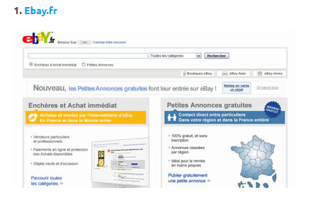
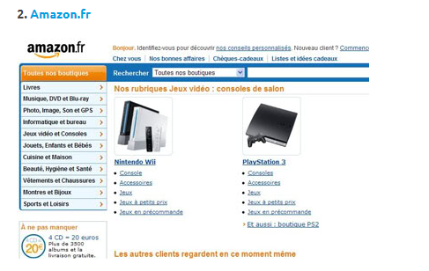
1. Ebay.fr
2. Amazon.fr

Slide 21
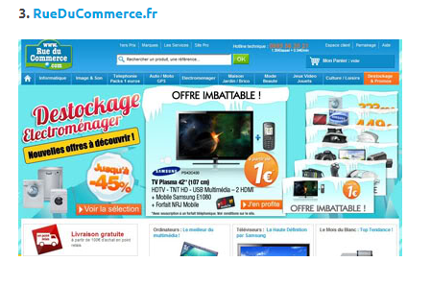
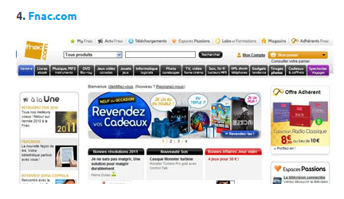
3. RueDuCommerce.fr
4. Fnac.com

Slide 22
c. Discount store
Compared to hyper/supermarkets, discount stores offer a smaller range of goods for lower prices.
At the end of 2015, there were 4,334 discount stores in France.
The top four hard-discount companies are Lidl, Aldi, Dia (former Ed), Leader Price.
Despite the economic crisis, the discount stores did not gain substantive market shares and actually decreased in number of stores.
Conventional supermarkets/hypermarkets have heavily stocked their low prices shelves in order to hinder the hard discount expansion.

Slide 23
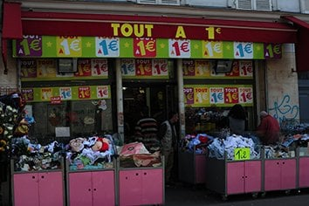
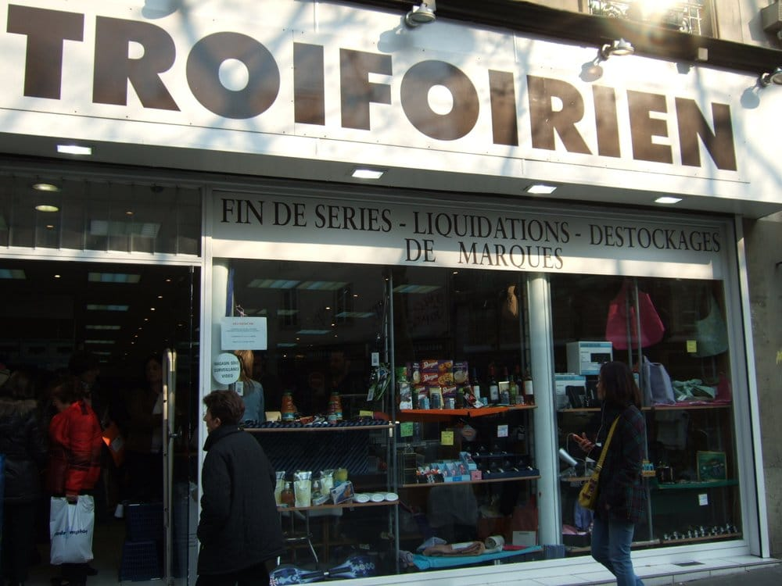
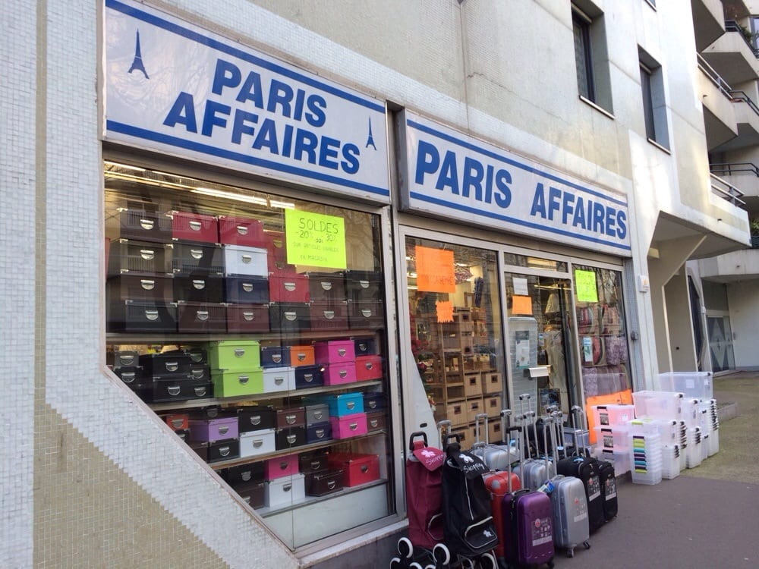
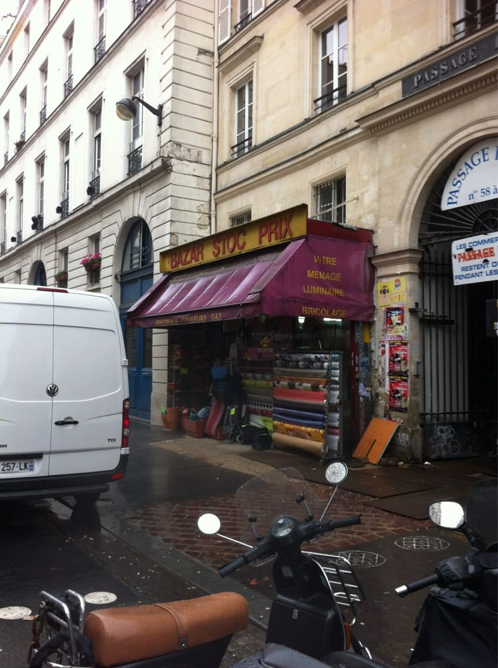
Tout à 1 Euro
Troifoirien
Paris Affaires
Bazar Stock Prix

Slide 24
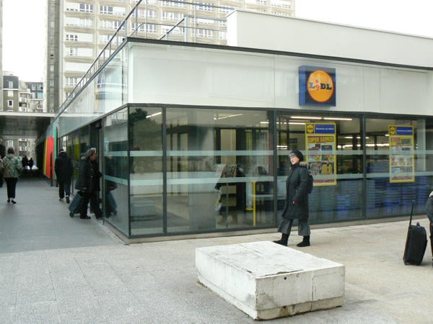
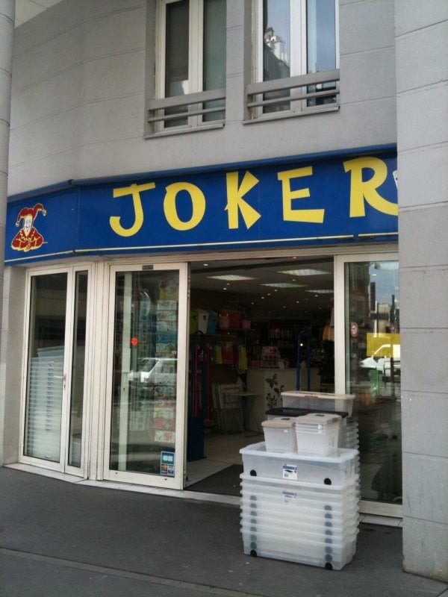
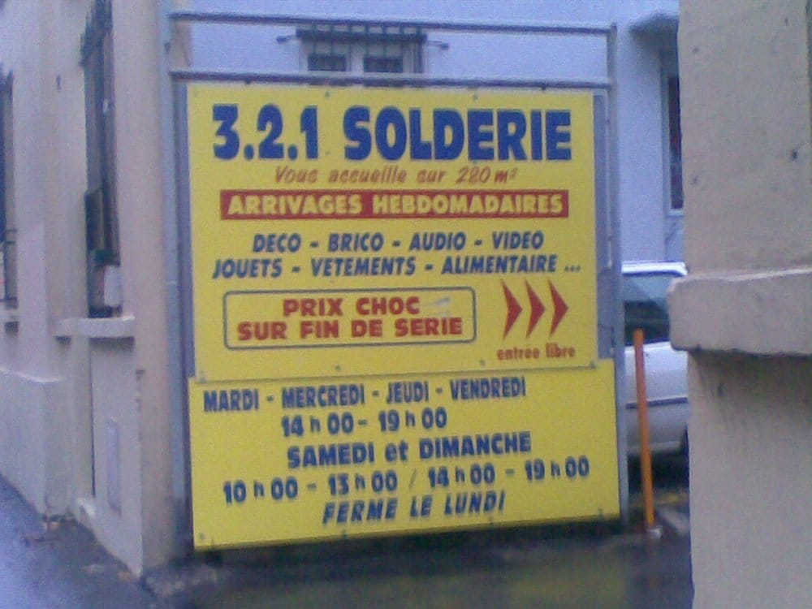
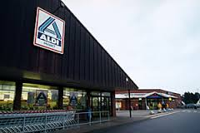
LIDL
Joker
3.2.1 Solderie
Aldi Nord

Slide 25


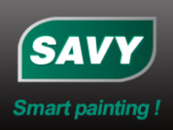
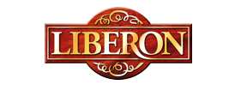
IV. Main brands of painting tools in France
Nespoli
www.nespoligroup.com
Bostik
www.bostik.com
Liberon
www.liberon.co.uk
Savy
www.savy.fr

Slide 26
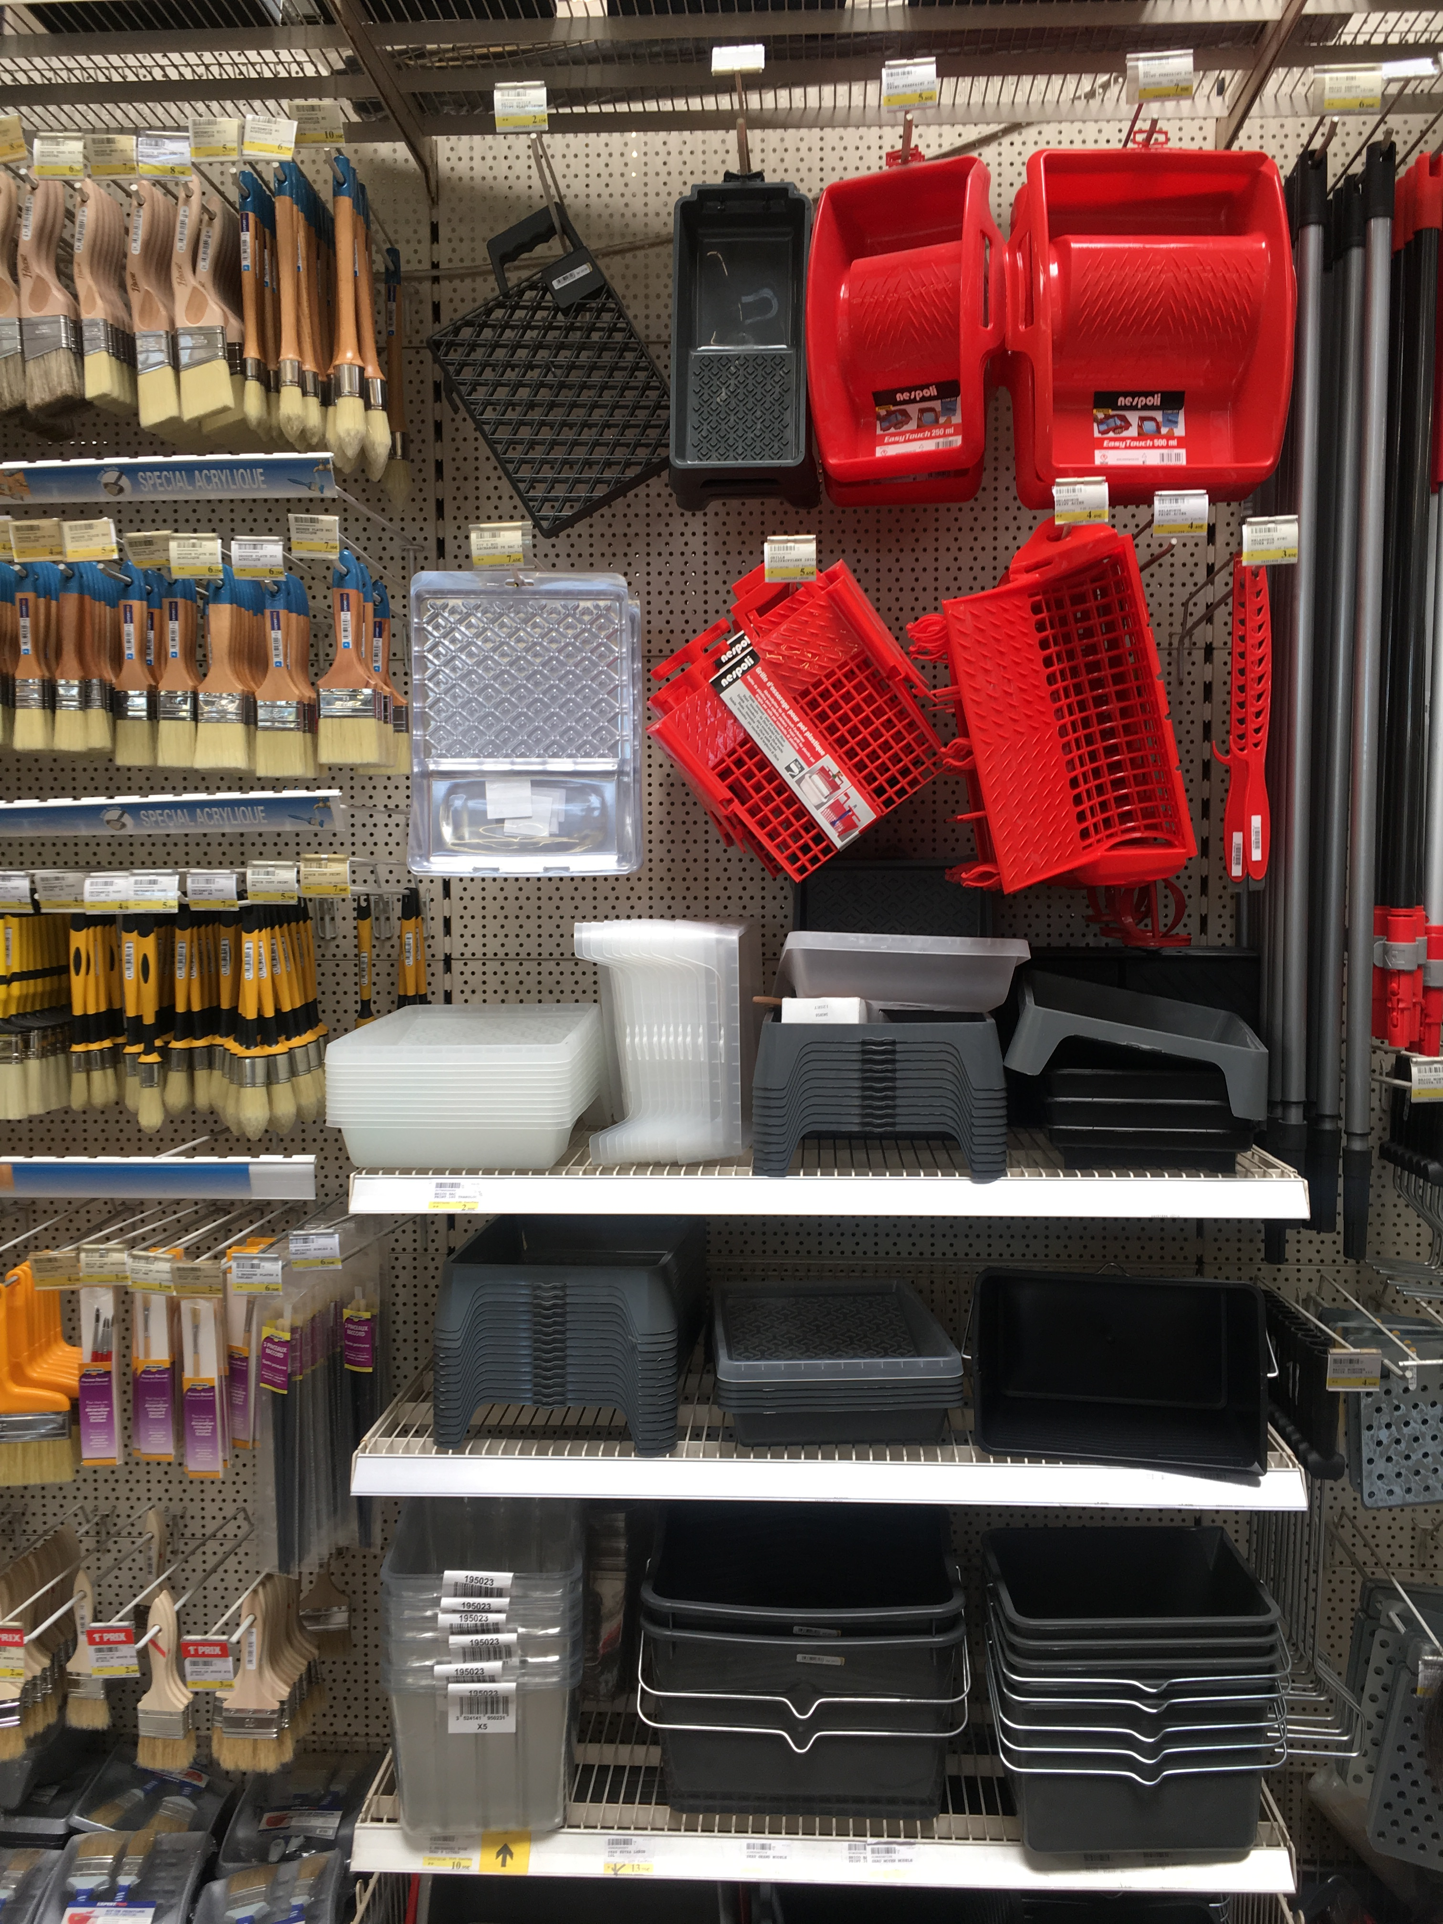
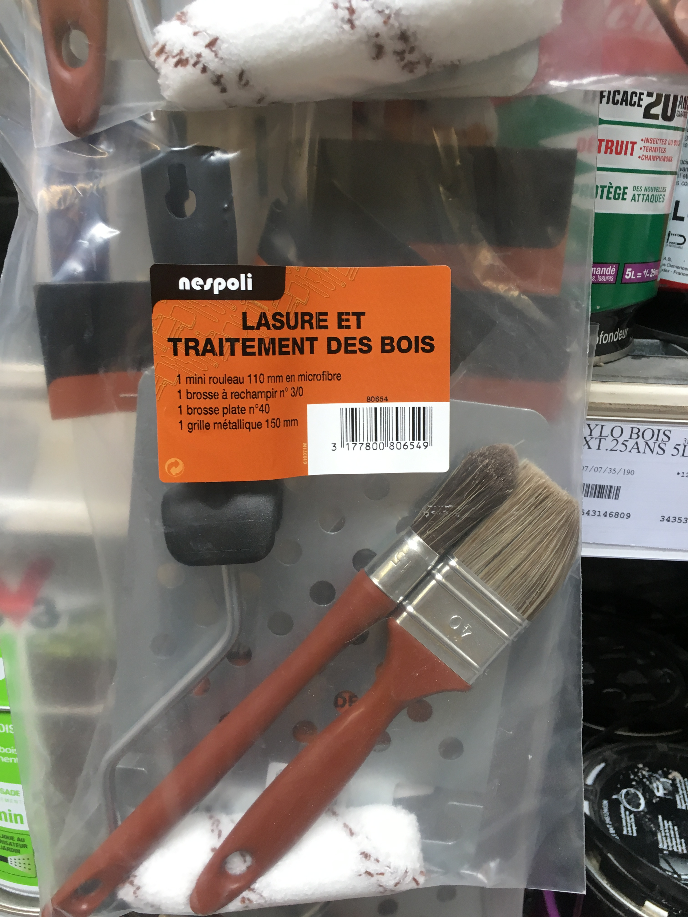
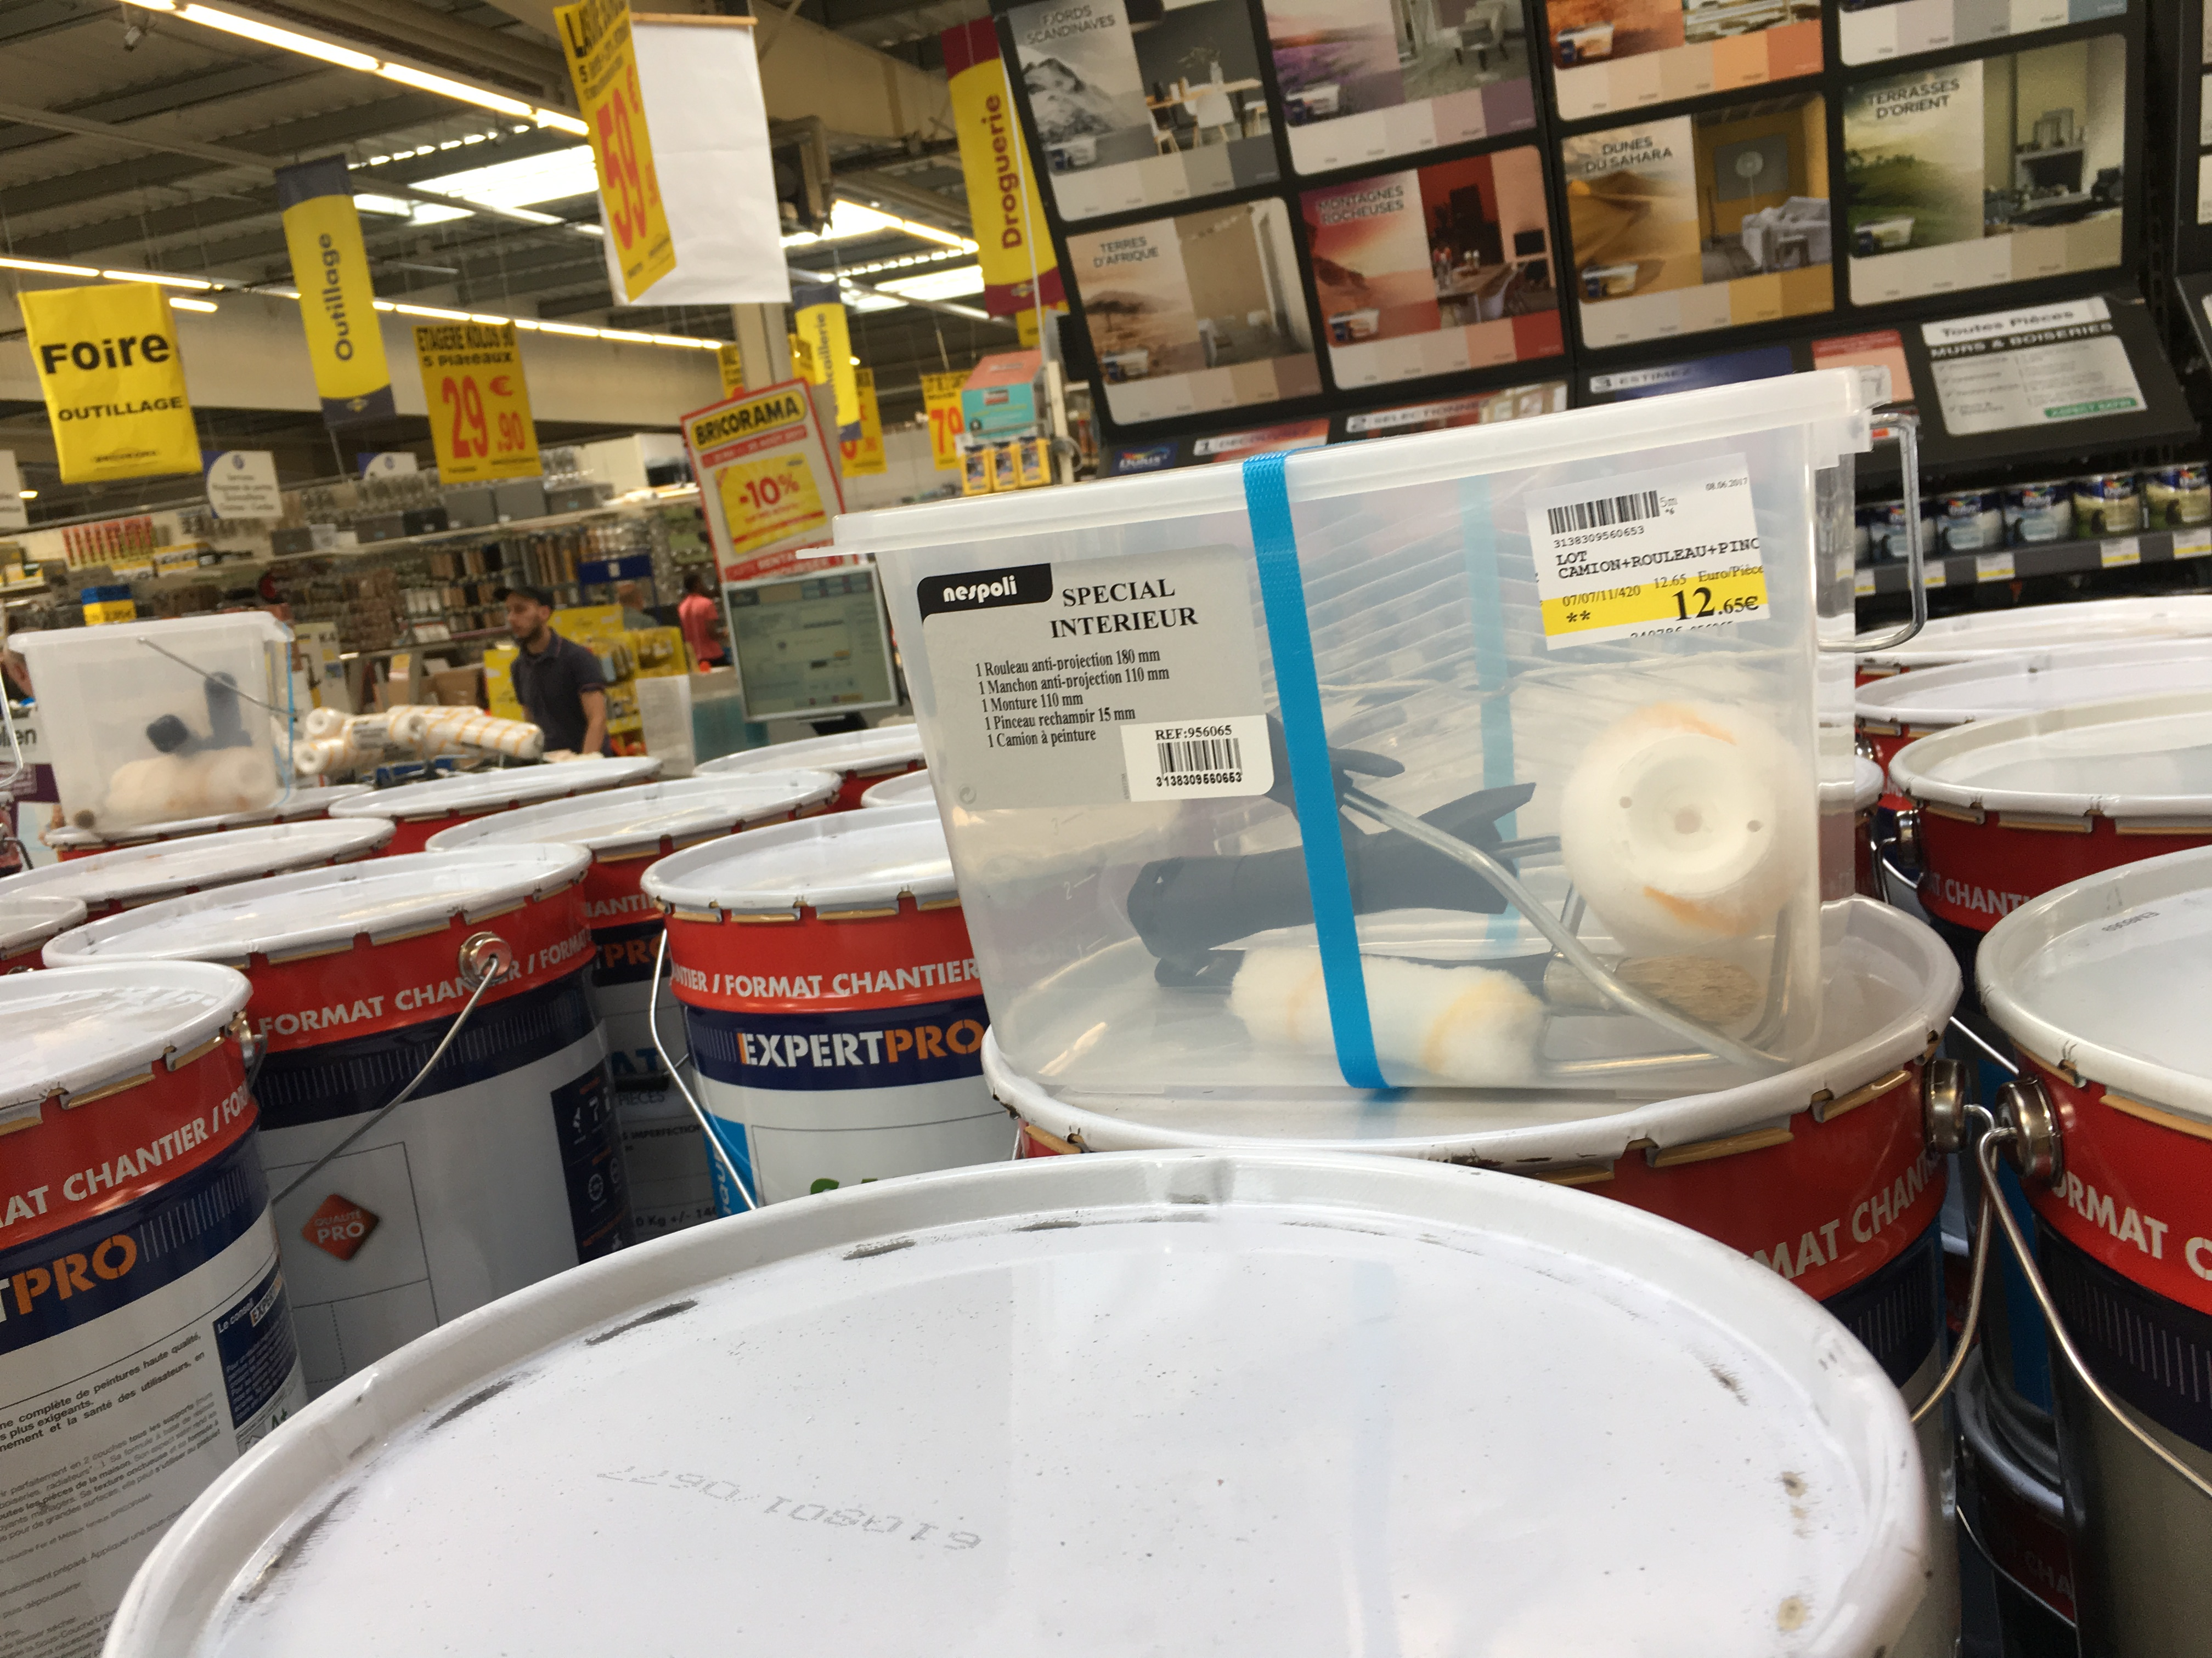
Nespoli

Slide 27
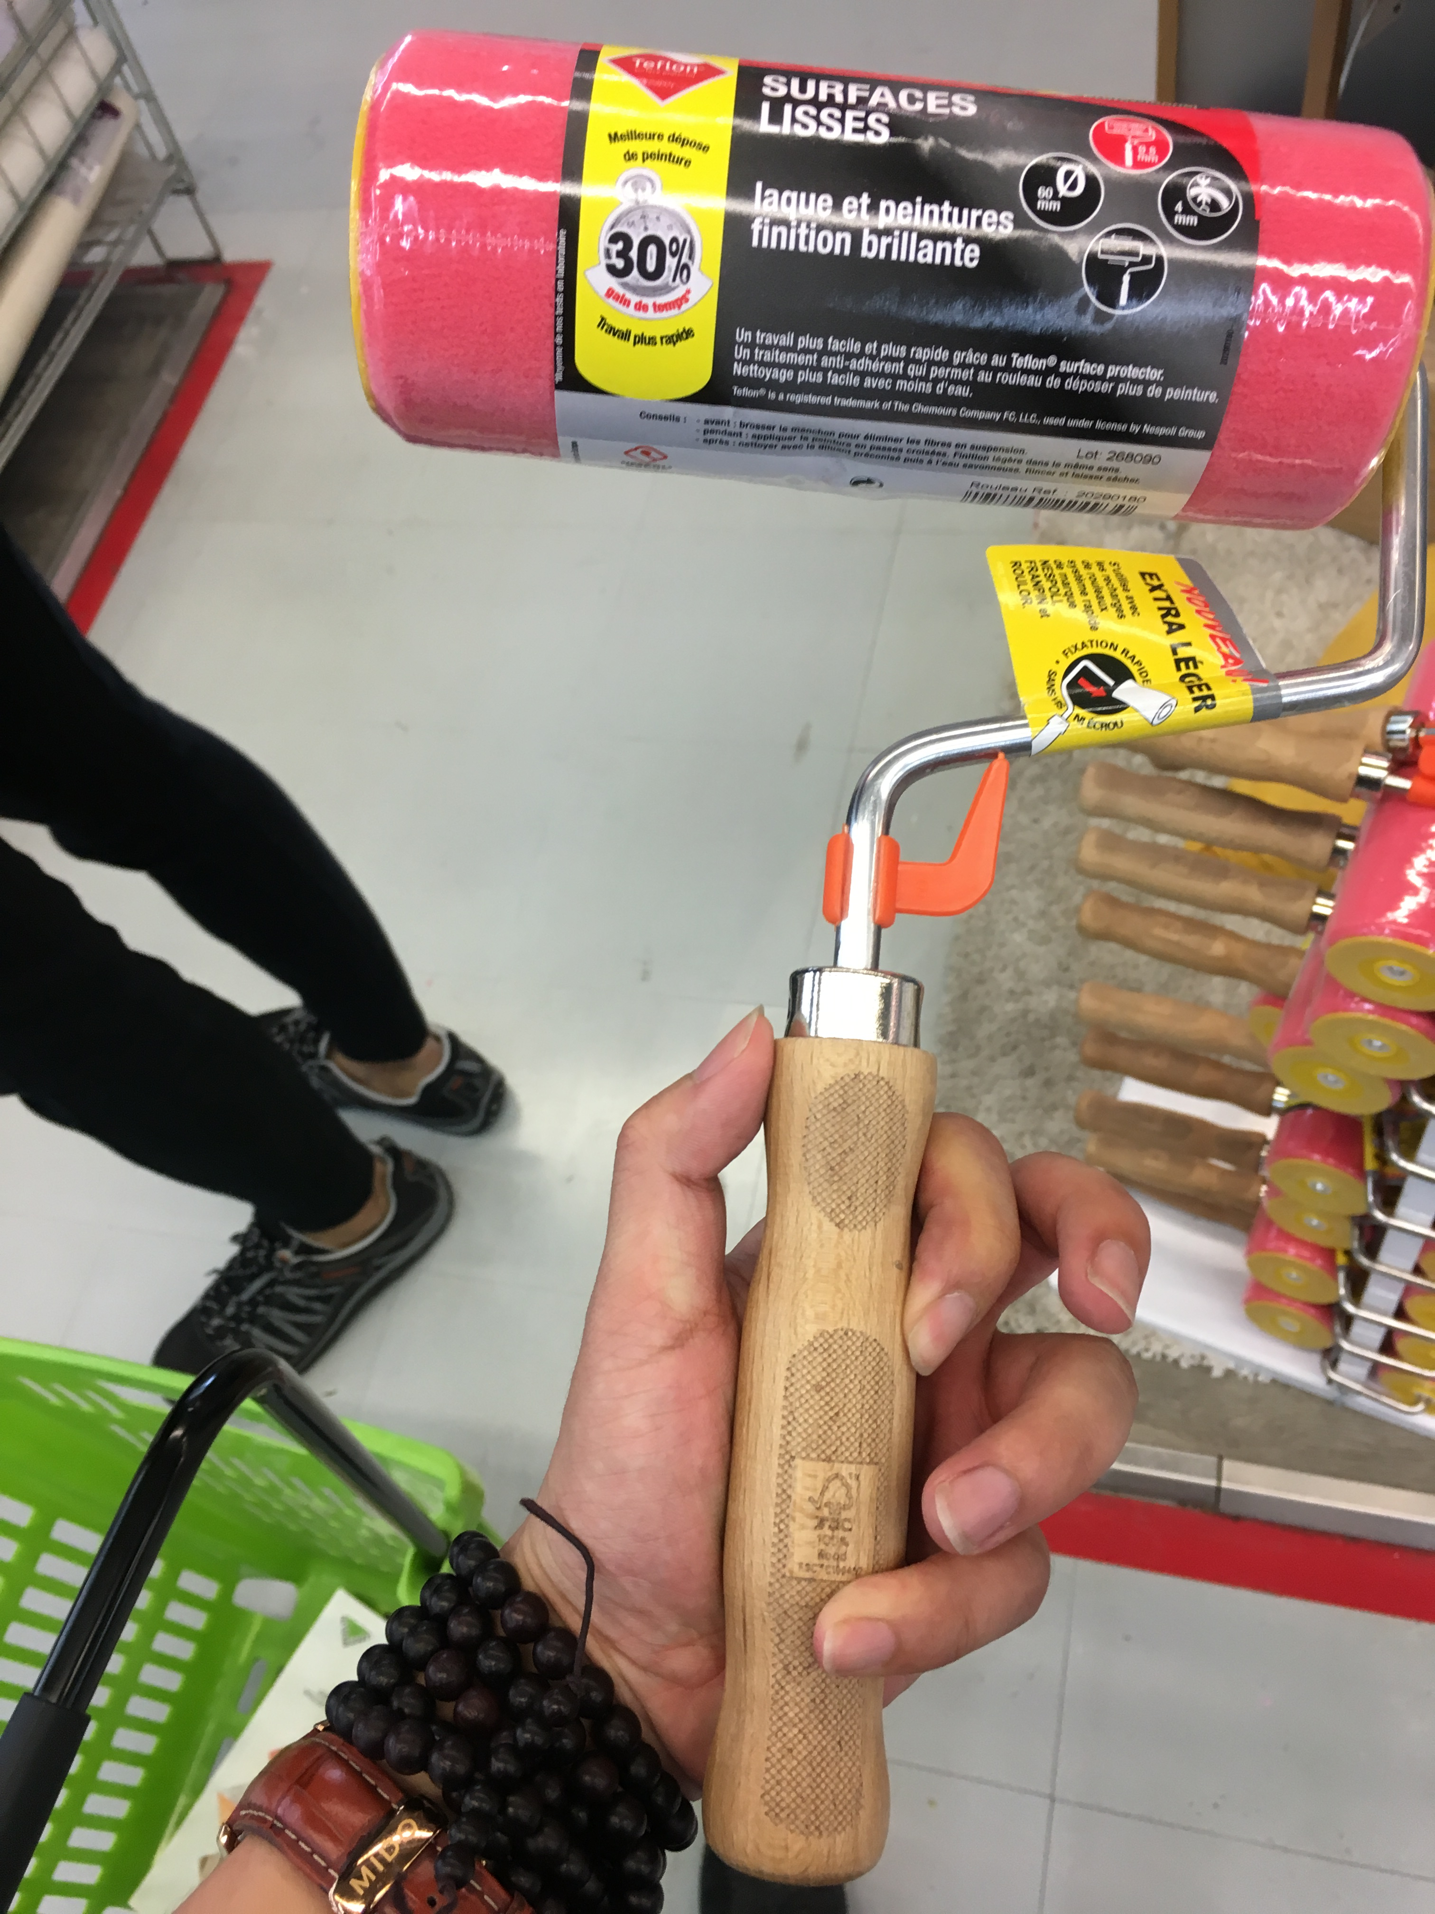
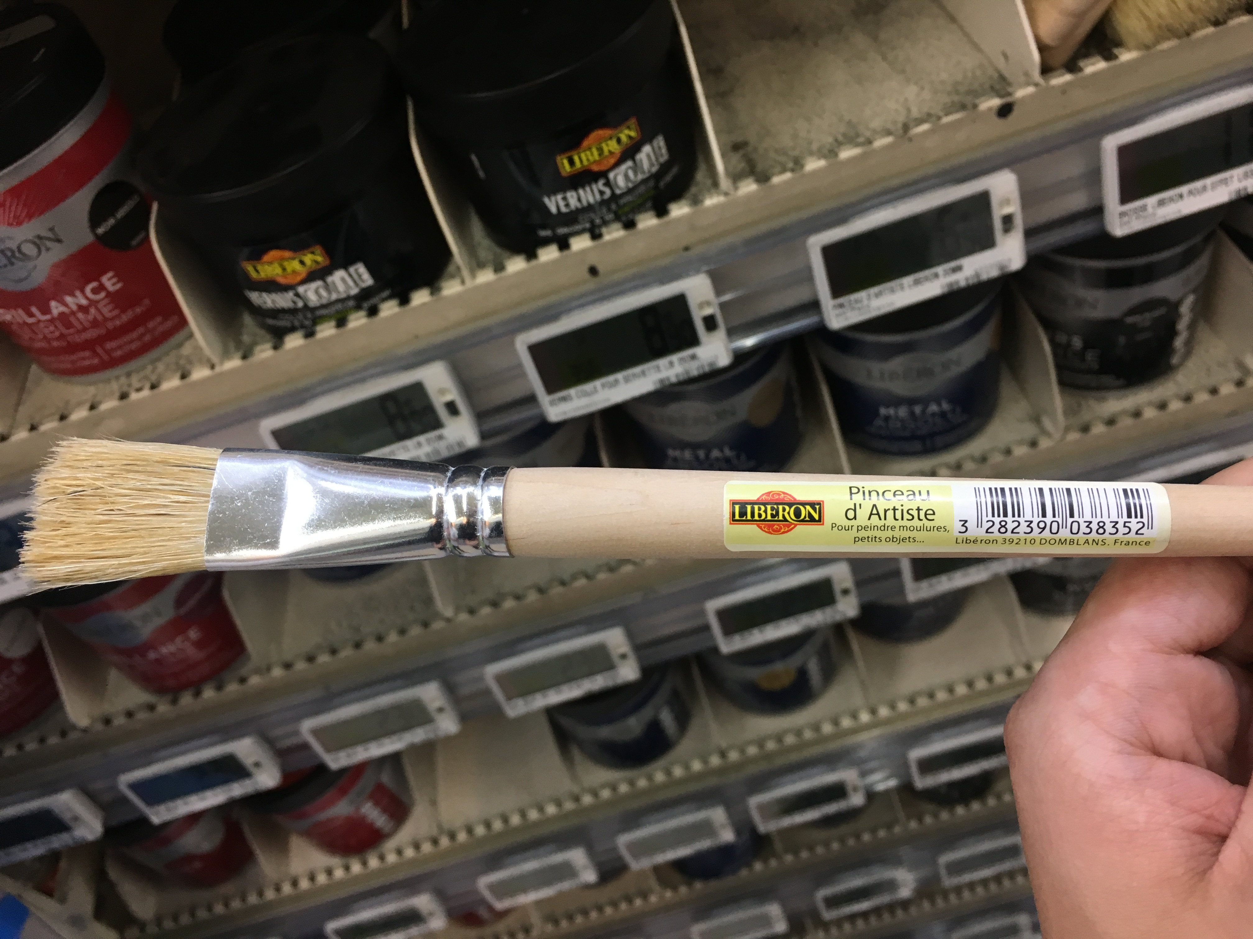
Teflen
Liberon

Slide 28
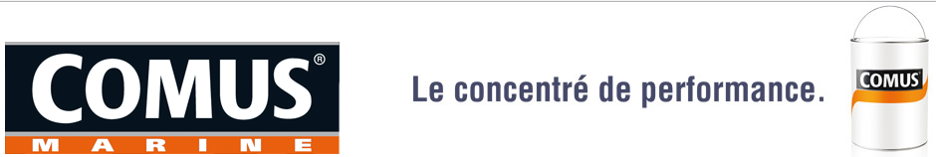
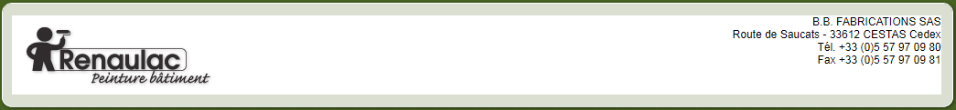
V. Main brands of paint manufacturer in France
COMUS MARINE
COMUS MARINE® is so far the only brand of marine paints.
www.comus-marine.com/peintures-yachting
RENAULAC
RENAULAC founded in 1827 by Charles Renault is one of the oldest French paintings. www.renaulac.fr

Slide 29
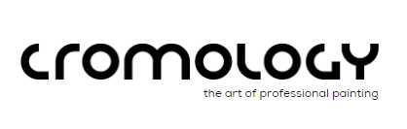

Cromology
Cromology is a world player in the decorative paint sector. The Group ranks in second place in France and is the market leader in Southern Europe (Italy, Spain and Portugal).
www.cromology.com/en
Weber
An expertise in the field of materials that goes back 350 years:
Saint-Gobain is recognized as one of the top 100 innovative companies in the world.
www.weber.fr/accueil.html

Slide 30


Monopol SAS
For more than 70 years, MONOPOL, French company belonging to UNIVERSAL Holding,
did not stop growing to take place in the very first rank of the industrial paints manufacturers.
www.monopol-sa.com
COLORAID
COLORAID is an original and powerful brand in the world of industrial painting, by its direct involvement in the rigorous and global control of your paint job. www.coloraid.fr

Slide 31
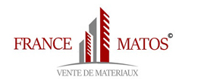
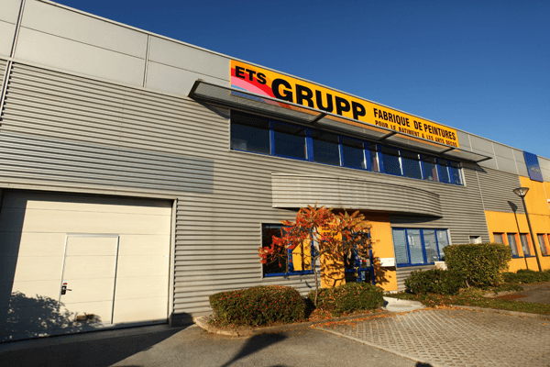
FRANCEMATOS - BEKAMENT FRANCE (Online and Offline)
Francematos - Wholesaler of building and renovation materials, exclusive dealer of the "Bekament" brand on the French market.
www.francematos.fr
GRUPP SAS (Online store)
www.peinture-grupp.fr

Slide 32
VI. Details of painting tools in France
Brush
Handle：Wooden,soft rubber grip
Filament：Natural Bristle and Synthetic Fibers mixed
Size: 20mm 30mm 40mm 50mm 60mm 80mm100mm
Roller
Handle: Wooden,soft rubber grip
Size: 2” 4” 6” 7” 9”
Nap:12mm
Core DIA:6mm 8mm
Cover Fabric: Acylic, Microfiber, Polymide, Polyester
Tray
Size: 7” 9” 8L 12L

Slide 33
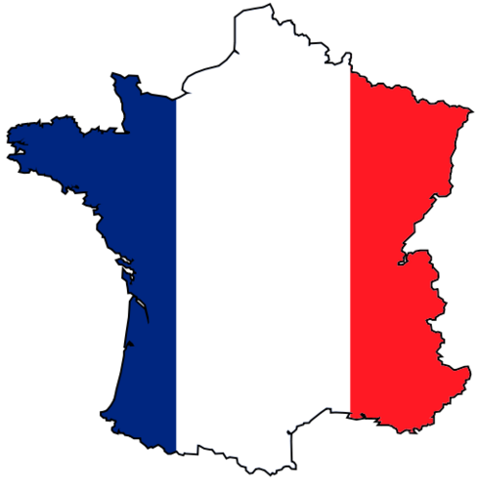
Thank you!

